Slide 1
Data Manipulation in R
Notes:
Welcome to the module on data manipulation with R

Slide 2
Data Manipulation in R
Manipulating data using base R
Using dplyr to manipulate data
Working with date objects
Merging tables
Missing value treatment
Using reshape2() to transpose data
Manipulating Character Strings
Using sqldf
Notes:
In this session we’ll discuss the following topics:
As far as the manipulation of tabular data is concerned we’ll discuss the base R functions and also we’ll demonstrate in detail about the functionality of a very powerful data manipulation package called dplyr(). Discussion on how date objects are manipulated in R will be undertaken. We’ll touch upon how two data frames can be joined together, how we deal with missing values and how simple transpositions can be done in R. For those who are very well versed at executing sql queries, we’ll briefly describe how sql queries can be executed from within R using sqldf() package.

Slide 3
Data Manipulation: Base R

Slide 4
Data Manipulation: Base R
Subsetting data
Selecting specified columns
Adding new columns
Reordering data (Ascending/Descending order)
Group wise operations
Producing contingency tables
Notes:
So, lets get started with data manipulation of tabular data using base R functions. The whole data manipulation exercise for tabular data (data in data frames) can be thought of as consisting of :
Subsetting the data: Selecting some rows out of our data frame
Selecting specific columns from our data frame
Adding new columns to our existing data frame
Arranging our data in ascending or descending order
Producing group wise summaries
Constructing contingency tables

Slide 5
Sub-setting data
Notes:
Siubsetting means selecting some rows out of our data frame. In order to understand this let us load a data in our R session.

Slide 6
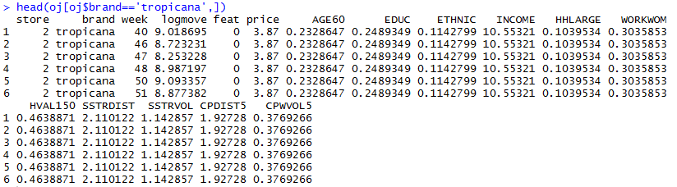
Manipulating data: Base R (Sub setting)
Sub setting: Selecting a sub set of rows across all columns

Slide 7
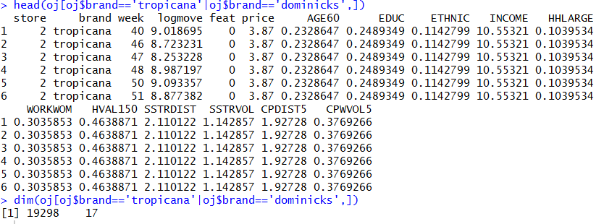
Manipulating data: Base R (Sub setting)
Can use multiple conditions, | (or), & (and) operator

Slide 8
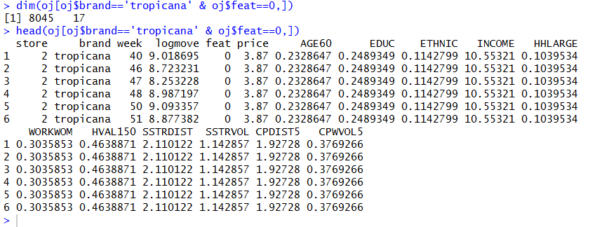
Manipulating data: Base R (Sub setting)

Slide 9
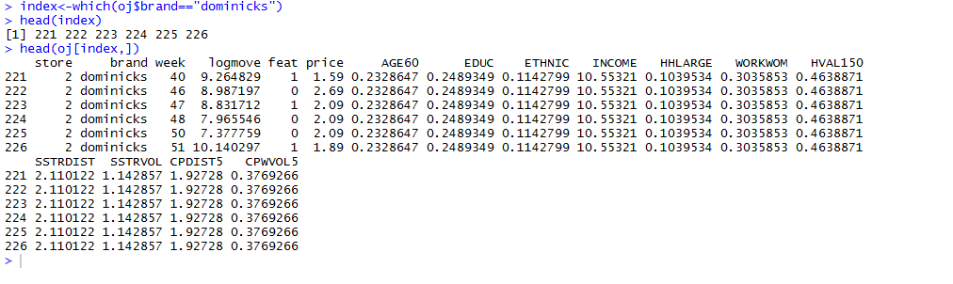
Manipulating data: Base R (Sub setting)
So, far logical sub-setting is discussed.
Use which() operator to get the index for specific rows

Slide 10
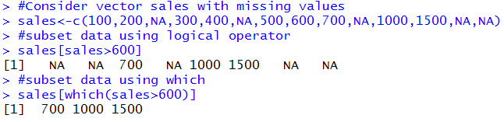
Logical vectors Vs. which
which() removes NA values in the logical vector
It only returns the indices where the logical vector is TRUE

Slide 11
Selecting Columns

Slide 12
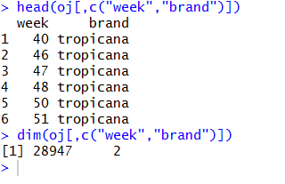
Manipulating data: Base R (Selecting)
Selecting a specified set of columns

Slide 13
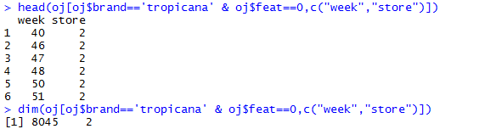
Manipulating data: Base R
Selecting + Sub-setting

Slide 14
Adding new columns

Slide 15
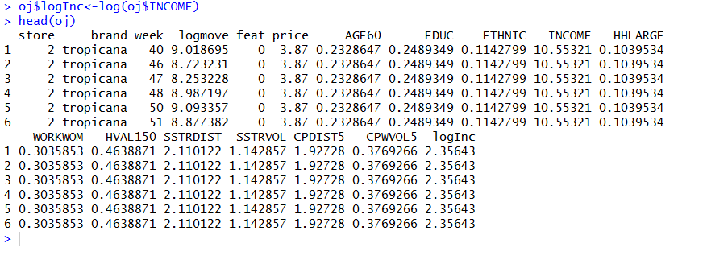
Manipulating data: Base R
Adding new columns

Slide 16
Ordering data

Slide 17
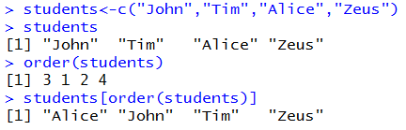
Ordering
order() returns the element order that results in a sorted vector
Application: Very useful for sorting dataframes

Slide 18
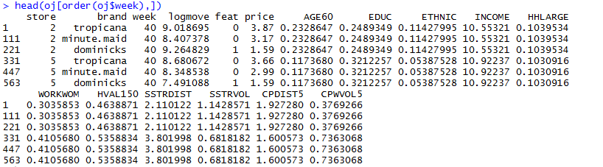
Manipulating data: Base R
Ordering data

Slide 19
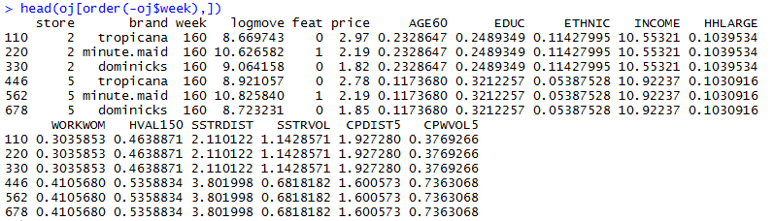
Manipulating data: Base R
Ordering data

Slide 20
Manipulating data: Base R
Subsetting data: Using logical subsets and which() statement
Selecting columns: Using column names at column index
Adding new columns: Use of $ operator
Re-ordering data: order()
Group Wise Summaries
Producing Contingency tables

Slide 21
GroupWise operations

Slide 22
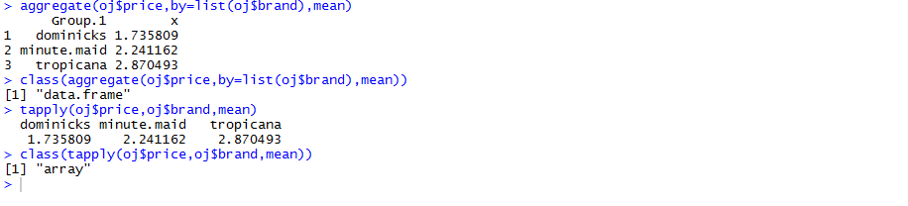
Manipulating data: Base R
GroupWise operations
tapply(), aggregate()
What is the mean price of each brand of juice across all stores?

Slide 23
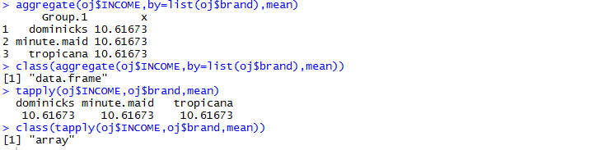
Manipulating data: Base R
GroupWise operations
tapply(), aggregate()
What is the mean income level corresponding to brand of juice across all stores?

Slide 24
Contingency tables

Slide 25
Manipulating data: Base R
Category wise counts: Contingency tables
Income | Age | Gender | Location
10,000,000 | 24 | M | Arizona
20,000,000 | 32 | F | California
15,000,000 | 28 | M | Arizona
18,000,000 | 26 | F | California

Slide 26
Manipulating data: Base R
Category wise counts: Contingency tables
Counts | California | Arizona
Male | 0 | 2
Female | 2 | 0
Income | California | Arizona
Male | 0 | 10,000,000+15,000,000
Female | 20,000,000+18,000,000

Slide 27

Manipulating data: Base R
Category wise counts: Contingency tables
table(), xtab()
Number of people who bought different brands categorized by presence of advertising campaigns

Slide 28

Manipulating data: Base R
Category wise counts: Contingency tables
table(), xtab()
Total income categorized by brand and presence of advertisements

Slide 29
Data Manipulation: dplyr

Slide 30
Manipulating data: dplyr
dplyr: Whats and Whys
Sub-setting data using filter()
Selecting columns using select()
Adding new columns using mutate()
Ordering data using arrange()
Summarizing using summarize() and group_by()
Using functional pipelines to do more than one manipulation task

Slide 31
Manipulating data: dplyr
Base R: Good for Medium sized data sets, Awkward Syntax
dplyr: Faster and elegant syntax
dplyr: Dataframes
install.packages(“dplyr”)
library(dplyr)

Slide 32
Sub-setting: filter()
Notes:
Do we know the topic number for this?

Slide 33
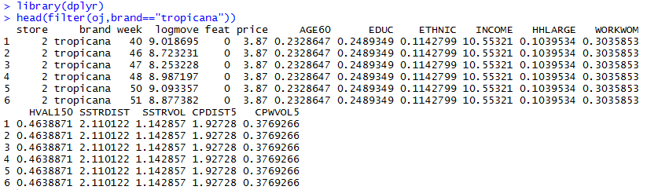
Manipulating data: dplyr
Sub-setting the data using filter(), base R equivalents: logical subsets and which()
Only that portion of data such that brand bought is “tropicana”

Slide 34
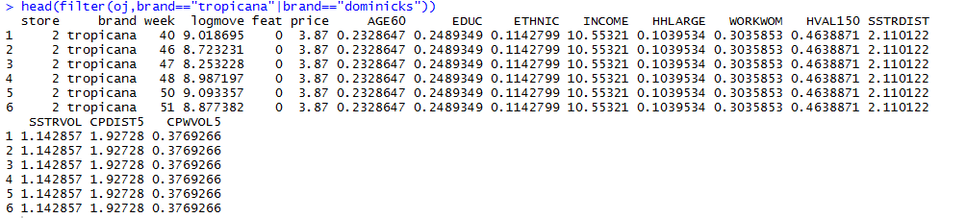
Manipulating data: dplyr
Sub-setting the data using filter(), base R equivalents: logical subsets and which()
Only that portion of data such that brand bought is “tropicana” or “dominicks”

Slide 35
Selecting Columns: select()
Notes:
Do we know the topic number for this?

Slide 36
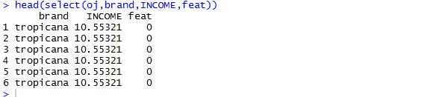
Manipulating data: dplyr
Selecting columns from data using select(), base R equivalents: index subsets
Selecting columns brand and income

Slide 37
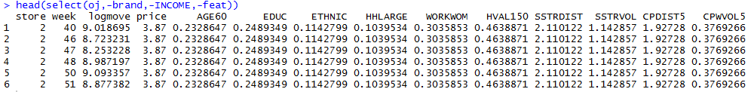
Manipulating data: dplyr
Selecting columns from data using select(), base R equivalents: index subsets
Dropping columns brand and income

Slide 38
Creating New Columns: mutate()
Notes:
Do we know the topic number for this?

Slide 39
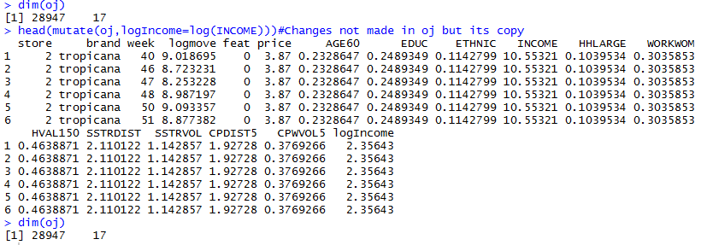
Manipulating data: dplyr
Adding columns to data using mutate(),
Adding a new column, log(income)

Slide 40
Ordering data: arrange()
Notes:
Do we know the topic number for this?

Slide 41
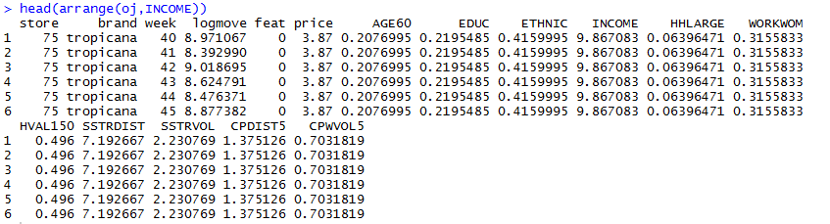
Manipulating data: dplyr
Ordering data using arrange(),
Order whole data by income in ascending order

Slide 42
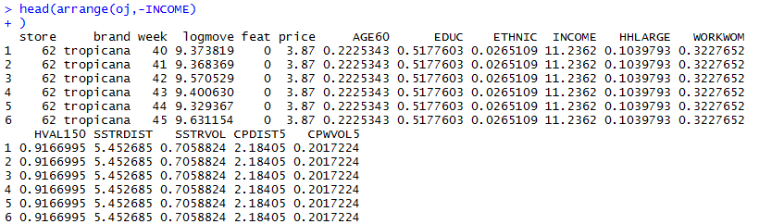
Manipulating data: dplyr
Ordering data using arrange(),
Order whole data by income in descending order

Slide 43
Summarizing data: summarize() and group_by()
Notes:
Do we know the topic number for this?

Slide 44
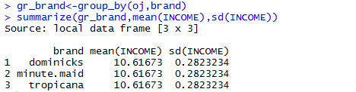
Manipulating data: dplyr
Summarizing data using summarize() and group_by()
group_by() makes grouped table, summarize() can take this grouped table and produce summaries for different columns
Mean level of income and standard deviation of income for each brand of orange juice

Slide 45
Functional Pipelines: %>%
Notes:
Do we know the topic number for this?

Slide 46
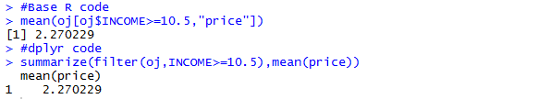
Manipulating data: dplyr
dplyr becomes a powerful tool when combined with %>% (pipe) operator
Several data manipulation tasks can be accomplished in just one line of code
Traditionally functional composition is achieved by using nested function calls
For example, Find the mean price for all people whose income is >=10.5

Slide 47
Manipulating data: dplyr
Clearly the code looks very messy, using a %>% operator, we can make it more readable
This can be easily read as:
Take data oj, filter it based on income
Take this filtered data frame and compute the mean of price

Slide 48
Manipulating data: dplyr
Subset the data based on price>=2.5, create a column logIncome, compute the mean, standard deviation and median of column logIncome

Slide 49
Manipulating Date objects
Notes:
Do we know the topic number for this?

Slide 50
Manipulating date objects
Dates are treated as a special data type in most programming languages
R also treats dates as a separate data type
Doing so, one can easily work with dates
Usual date operations include:
Finding time interval between two points in data: age
Extracting months and week days

Slide 51
Manipulating date objects
Character to date conversion-Date Class
Extracting months and weekdays
Using difftime()
Manipulating data involving dates
POSIXct and POSIXlt Classes
Working with lubridate()

Slide 52
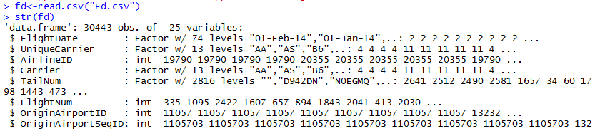
Manipulating date objects
Using Date class to convert a character into a Date.

Slide 53
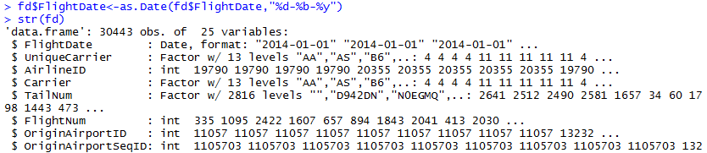
Manipulating date objects
Using Date class to convert a character into a Date.

Slide 54
Manipulating date objects
Using Date class to convert a character into a Date.
Code | Value
%d | Day of month (decimal number)
%m | Month (decimal number)
%b | Month (abbreviated)
%B | Month (full name)
%y | Year (2 digits)
%Y | Year (4 digits)
25/Aug/04: “%d/%b/%y
25-August-2004:%d-%B-%Y

Slide 55
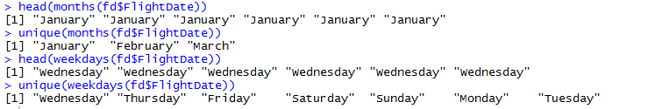
Manipulating date objects
Extracting months and weekdays from data:

Slide 56
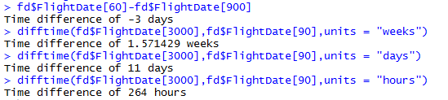
Manipulating date objects
Computing time intervals and using difftime()

Slide 57
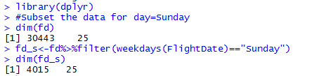
Manipulating date objects
Manipulating data involving dates
Sub-setting data: All rows when the day is Sunday

Slide 58
Manipulating date objects
Manipulating data involving dates
Find the number of flights on Sundays for destination Atlanta

Slide 59
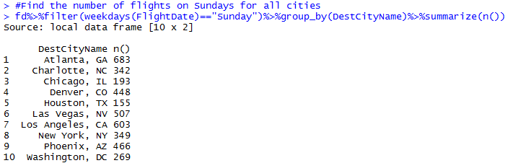
Manipulating date objects
Manipulating data involving dates
Find the number of flights on Sundays for all cities

Slide 60
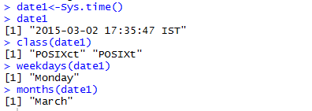
Manipulating date objects
Whenever data has time information along with date, we use POSIXct and POSIXlt classes to deal with dates

Slide 61

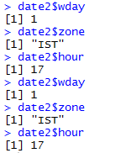
Manipulating date objects
Whenever data has time information along with date, we use POSIXct and POSIXlt classes to deal with dates

Slide 62
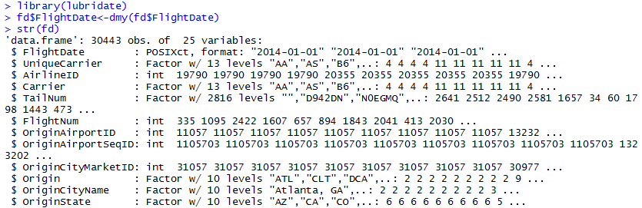
Manipulating date objects
lubridate() is a package that is a wrapper for POSIXct class
It has a very simple syntax.

Slide 63
Manipulating date objects
lubridate() is a package that is a wrapper for POSIXct class
It has a very simple syntax.
Function | Date
dmy() | 26/11/2008
ymd() | 2008/11/26
mdy() | 11/26/2008
dmy_hm() | 26/11/2008 20:15
dmy_hms() | 26/11/2008 20:15:30

Slide 64
Joining dataframes
Notes:
Do we know the topic number for this?

Slide 65
Joining dataframes
Just like tables can be joined in sql, we can perform joins on dataframes in R
Following types of joins can be accomplished
Inner Join
Left outer join
Right outer join
Full outer join

Slide 66
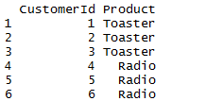

Joining dataframes
Inner join: Joining two tables based on a key column, such that rows matching in both tables are selected.

Slide 67

Joining dataframes
Inner join: Joining two tables based on a key column, such that rows matching in both tables are selected.

Slide 68
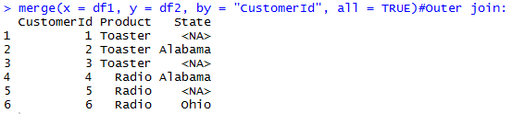
Joining dataframes
Full Outer Join: Two tables are joined irrespective of any match between the rows

Slide 69
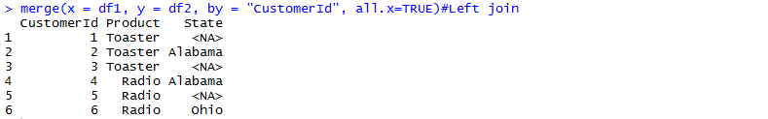
Joining dataframes
Left Outer Join: All the rows of left table are retained while matching rows of right table are displayed

Slide 70

Joining dataframes
Right Outer Join: All the rows of right table are retained while matching rows of left table are displayed

Slide 71
Missing Values

Slide 72
Missing Values
Identifying missing values in a column
Imputing missing values

Slide 73

Missing Values
Using is.na() to find out the total number of missing values

Slide 74
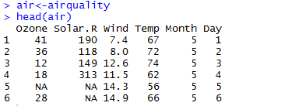
Missing Values
Using is.na() to find out the total number of missing values

Slide 75
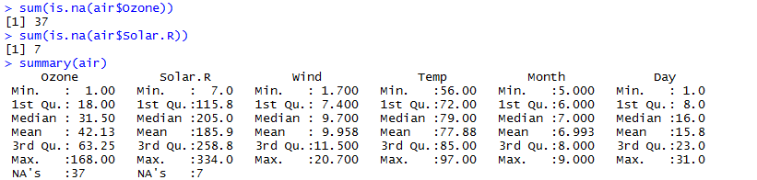
Missing Values
Using is.na() to find out the total number of missing values

Slide 76
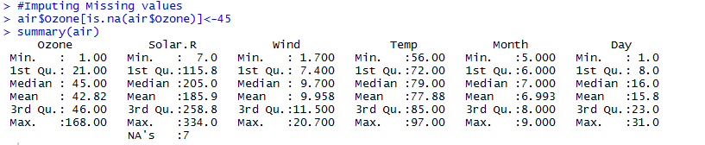
Missing Values
Imputing missing values

Slide 77
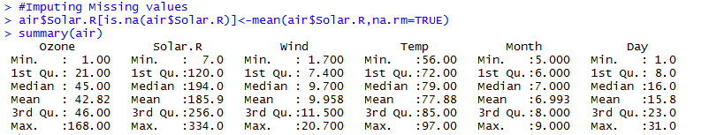
Missing Values
Imputing missing values

Slide 78
Transposing data: reshape2()
Notes:
Do we know the topic number for this?

Slide 79
Transposing data
Understanding wide and long data formats
Converting data in wide format to long
Converting data in long format to wide

Slide 80
Transposing data
Understanding wide and long data formats
Most structured data is in wide format: Variables are columns and Row labels identify observations
Person | Age | Weight
Sankar | 26 | 70
Aiyar | 24 | 60
Singh | 25 | 65

Slide 81
Transposing data
Understanding wide and long data formats
The same data can be represented as follows (long format)
Persons | Variable | Value
Sankar | Age | 26
Sankar | Weight | 70
Aiyar | Age | 24
Aiyar | Weight | 60
Singh | Age | 25
Singh | Weight | 65

Slide 82
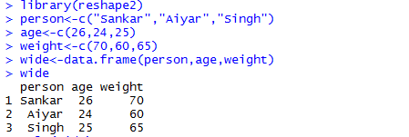
Transposing data
Converting a wide format data to long format: melt()

Slide 83
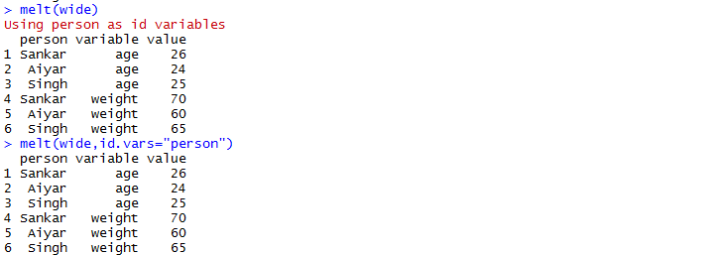
Transposing data
Converting a wide format data to long format: melt()

Slide 84
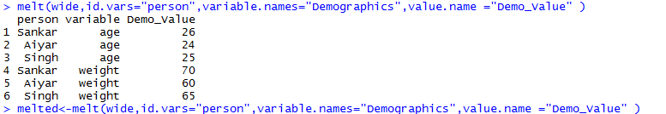
Transposing data
Converting a wide format data to long format: melt()

Slide 85

Transposing data
Converting a long format data to wide format: dcast()

Slide 86
Manipulating Strings in R
Notes:
Do we know the topic number for this?

Slide 87
Manipulating Strings in R
We’ll cover the following R functions used to manipulate character data
substr()
nchar()
tolower(), toupper()
strsplit(),paste()
grep(),grepl(),
sub(),gsub()

Slide 88
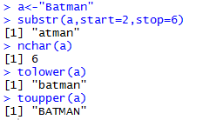
Manipulating Strings in R
substr(), nchar(),tolower(),toupper()

Slide 89
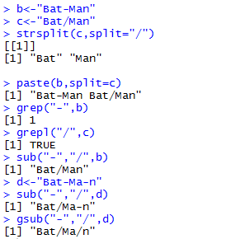
Manipulating Strings in R
strsplit(), paste(),grep(),grepl(),sub(),gsub()

Slide 90
Using sql commands within R

Slide 91
SQL queries within R: sqldf
One can easily use sql queries within R using a package called sqldf
This package is available at CRAN
install.package(sqldf)
library(sqldf)

Slide 92
SQL queries within R: sqldf
Using select statement
Using where statement
Using order by statement

Slide 93
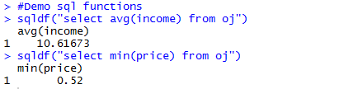
SQL queries within R: sqldf
Using sql functions

